Slide 1
TRACKING SPREADSHEET
This is one of the tools used to keep Managers and their teams updated with the progress of a certain project.

Slide 2
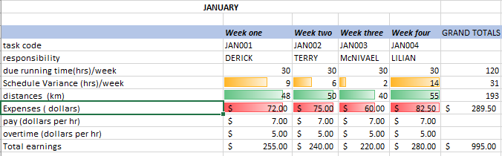
CREATE A MONTHLY OUTLOOK
HIGHLIGHT WEELKLY SCHEDULES.
ESTABLISH WEEKLY TASK CODES.
ASSIGN THE TASKS BY NAME OR ID.
GIVE THE DUE TIME TO COMPLETE THE TASK.
RECORD TIME VARIANCE AGAINST THE ORIGINAL SCHEDULE.
DISTANCE COVERED FOR THE TASKS.
EXPENSES.
PAYMENTS.
OVERTIME PAYMENTS.
TOTAL EARNINGS.

Slide 3
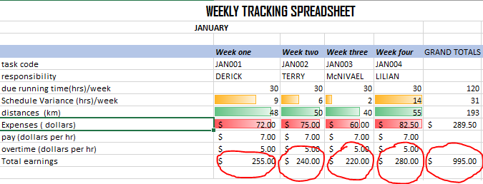
FEATURES ADDED
Summation of due time, schedule variance ,distances , expenses and total earning from task payments and overtime.
E.g. week one
DERICK EARNINGS
Pay 7$/ hr. * 30 hrs. = 210$
Overtime 5$/hr. * 9hrs. = 45$
TOTAL = 255$
Then the grand total of total earnings for all employees on tasks
(In this case due time, pay rates(7$/hr. and 5$/hr.) are constant rates)

Slide 4
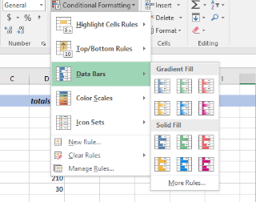
Conditional formatting with Data Bars is added on the following
due time to complete the task.(orange)
distances.(green)
record time variance against the original schedule(pink)
Gradient fill is used(with unique colors)

Slide 5
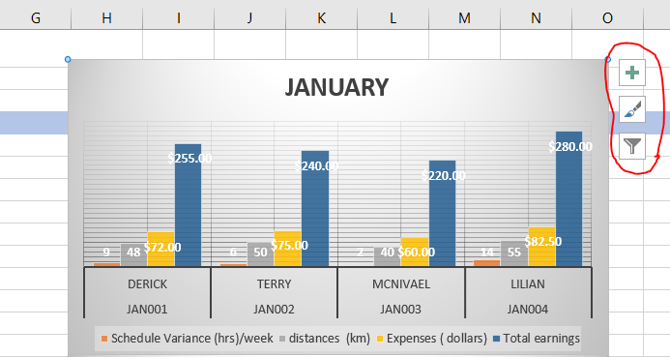
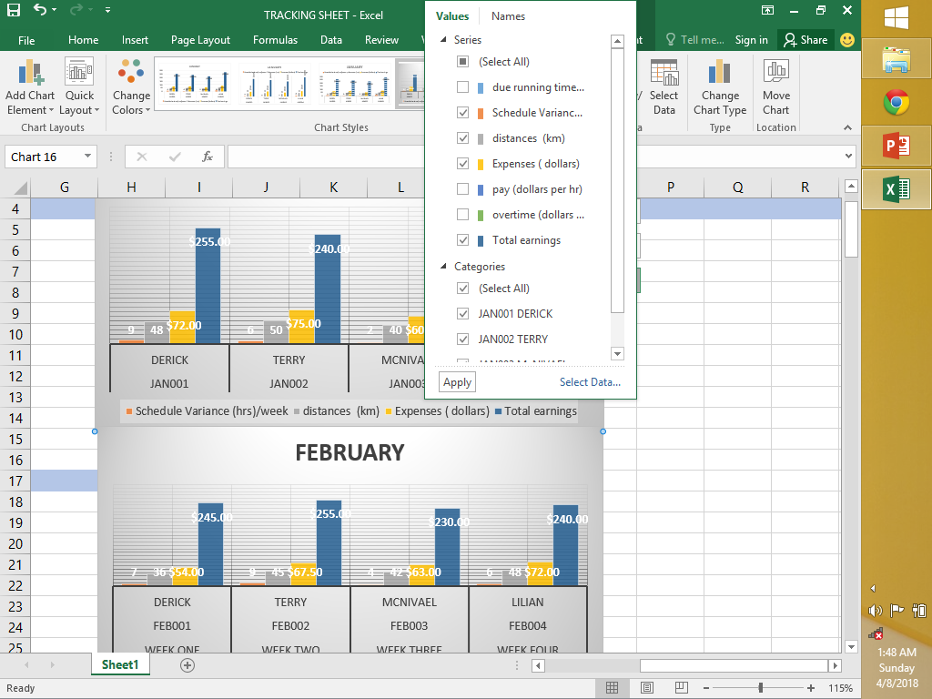
Graphical representation of January weeks.
Maximized gridlines for accuracy. (pop up option in red )
Filter out the constant values by deselecting them.

Slide 6
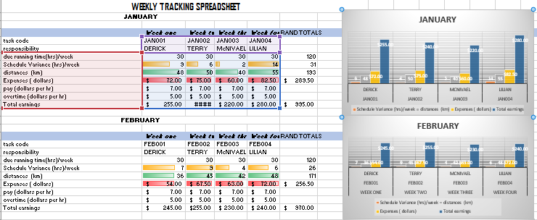
Generate graphs from the hypothetical data collected in the weeks of every month.
Data of interest is left for further analysis.

